Slide 1
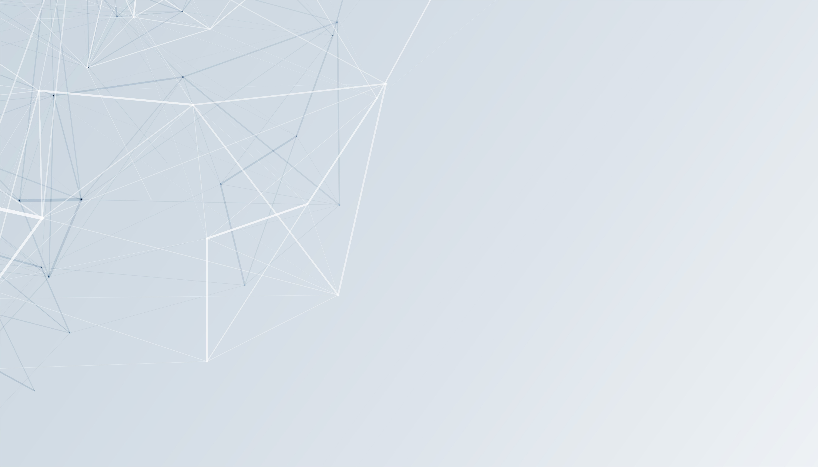

Project Rafeeq
First Milestone
Rafeeq
Browser-Based Accessibility Extension
What is Rafeeq?
An adaptive, multi-modal digital ecosystem that bridges communication gaps for people with diverse disabilities: Deaf/Mute, Blind, Dyslexic users.
What makes it different?
Rather than a standalone mobile app, Rafeeq is architected as a lightweight browser extension that injects assistive UI overlays and real-time processing directly into mainstream web communication platforms such as Web and Facebook. meeting users where they alreadyWhatsApp communicate.

Slide 2
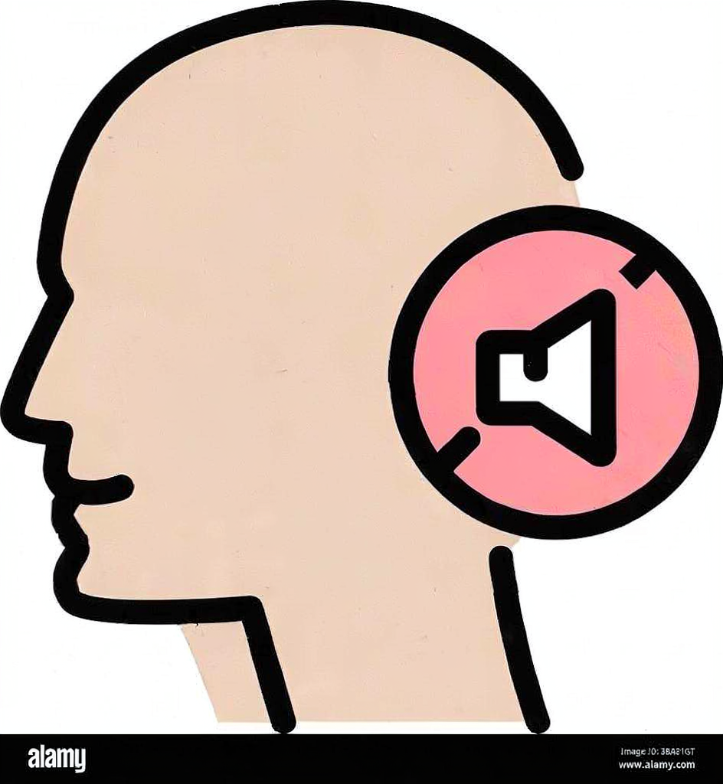
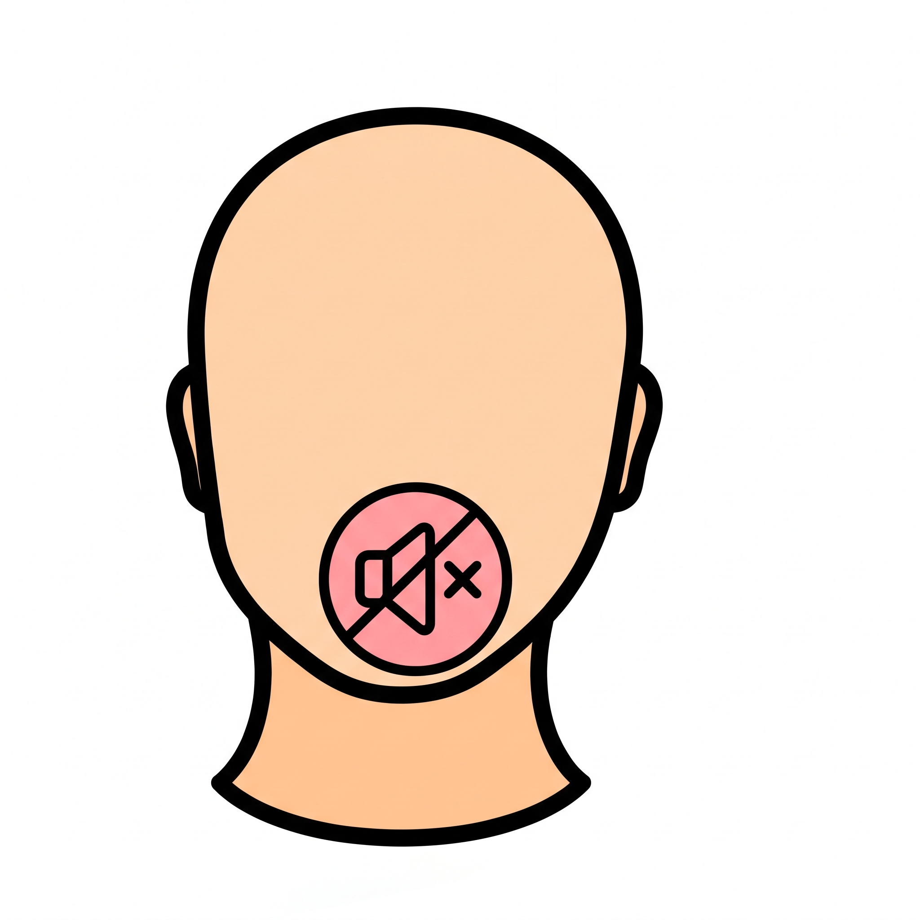
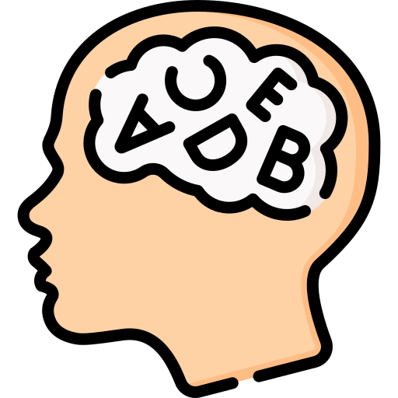
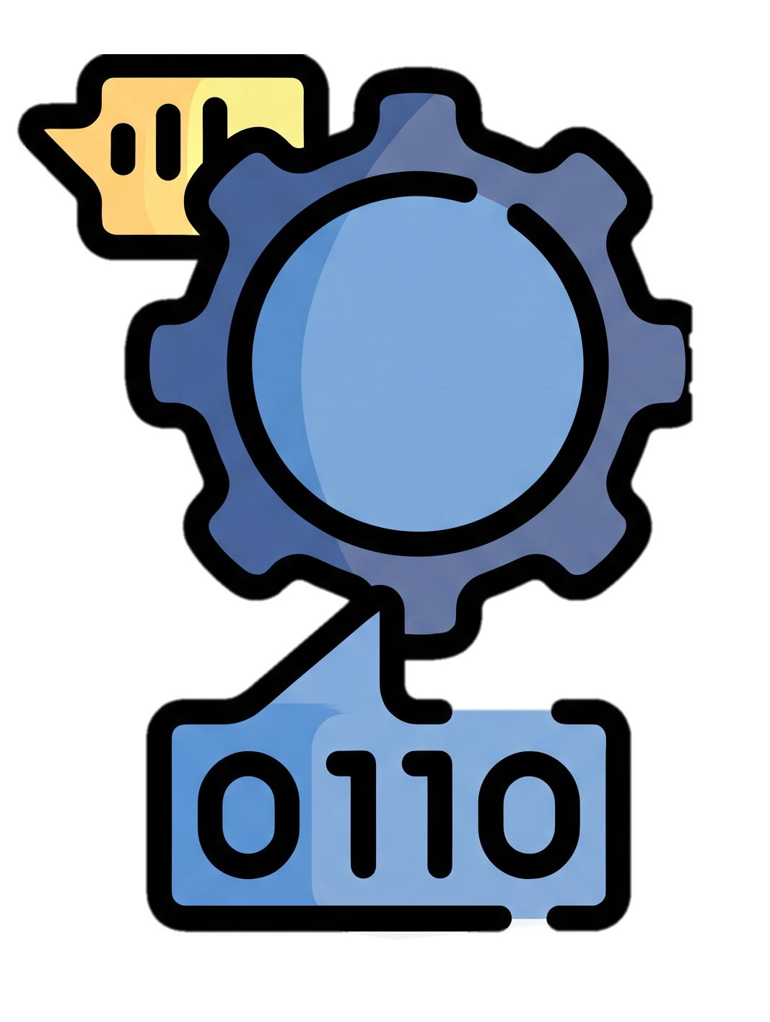
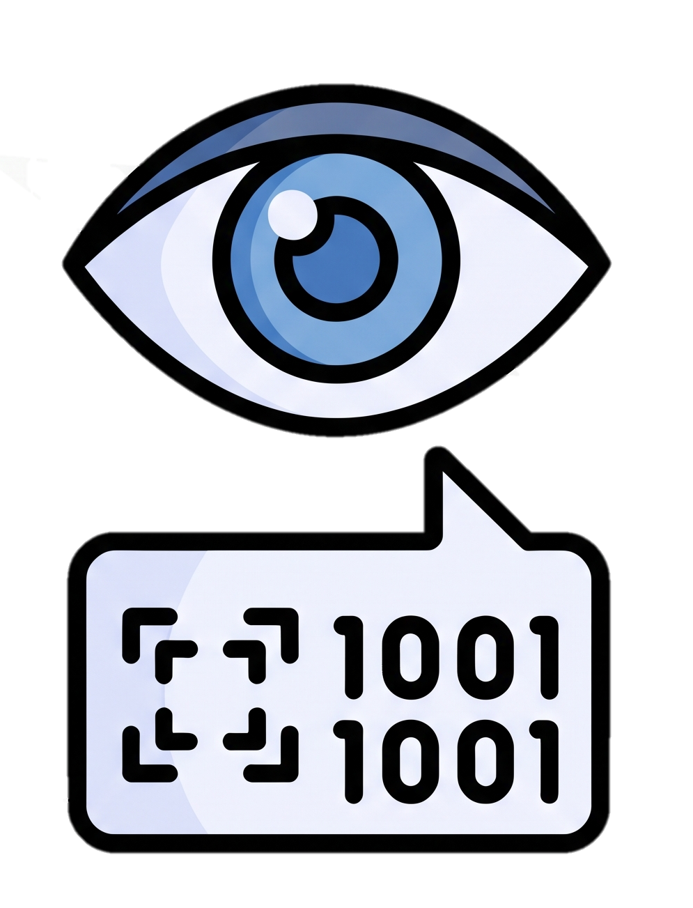
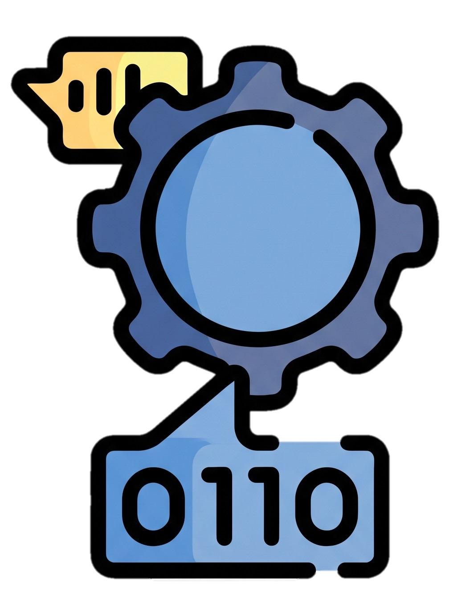
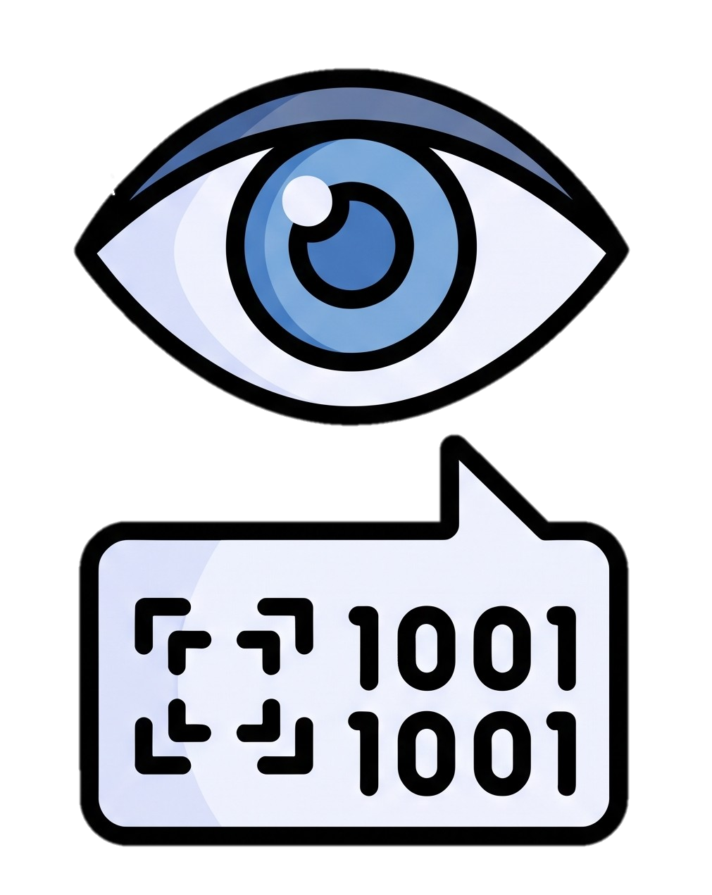
Project Rafeeq
First Milestone
Browser-Based Accessibility Extension
What is Rafeeq?
An adaptive, multi-modal digital ecosystem that bridges communication gaps for people with diverse disabilities: Deaf/Mute, Blind, Dyslexic users.
What makes it different?
Rather than a standalone mobile app, Rafeeq is architected as a lightweight browser extension that injects assistive UI overlays and real-time processing directly into mainstream web communication platforms such as Web and Facebook. meeting users where they alreadyWhatsApp communicate.
Some Talking About Sickness? (Soft Stuff)

Slide 3
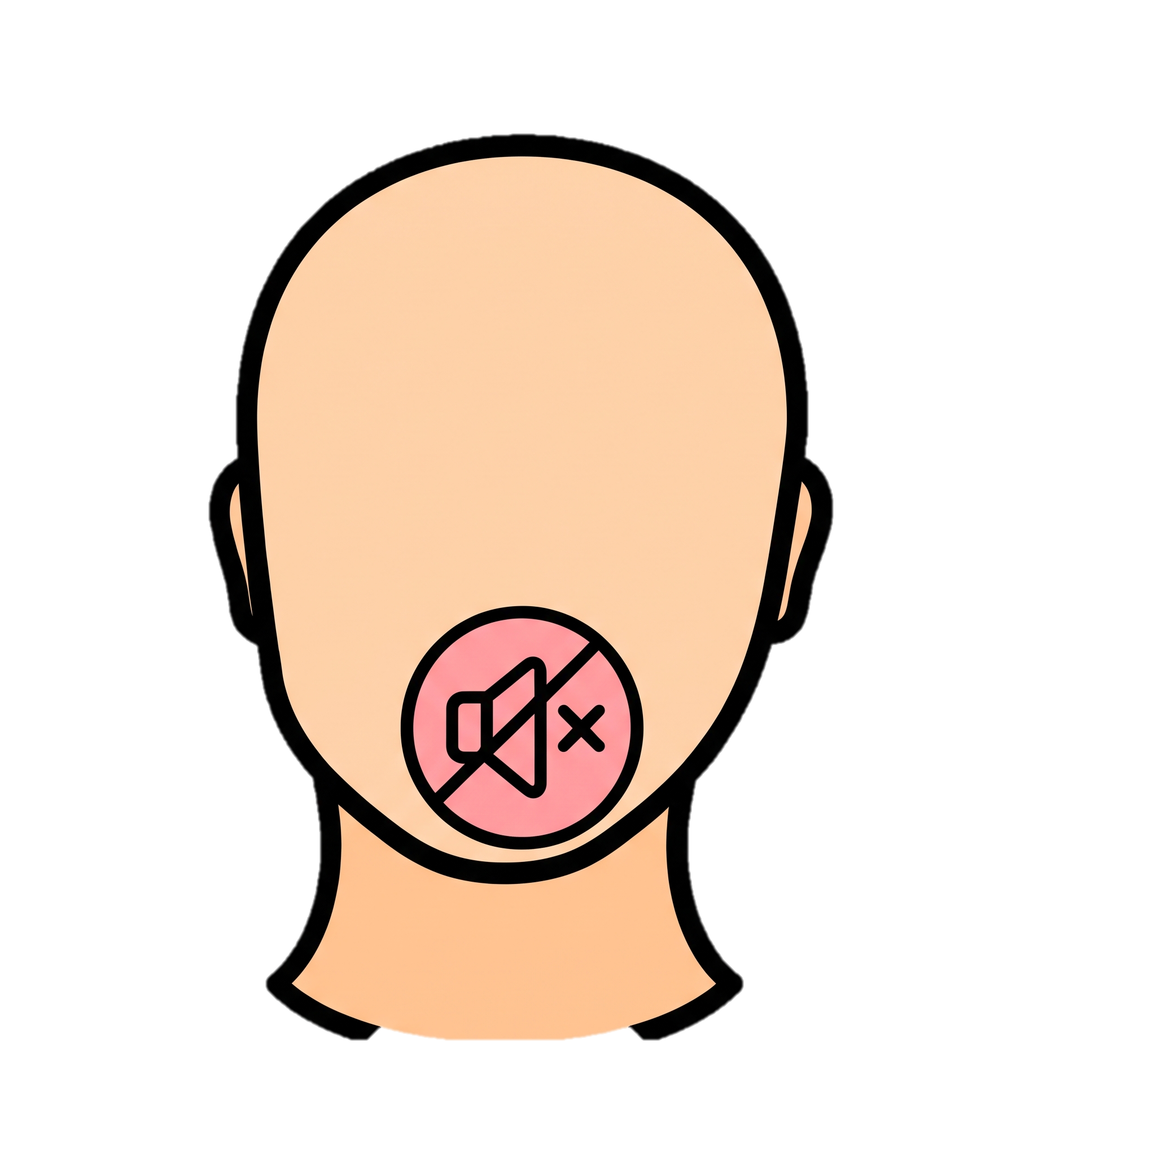
Project Rafeeq
First Milestone
What is Rafeeq?
An adaptive, multi-modal digital ecosystem that bridges communication gaps for people with diverse disabilities: Deaf/Mute, Blind, Dyslexic users.
What makes it different?
Rather than a standalone mobile app, Rafeeq is architected as a lightweight browser extension that injects assistive UI overlays and real-time processing directly into mainstream web communication platforms such as Web and Facebook. meeting users where they alreadyWhatsApp communicate.
Browser-Based Accessibility Extension
Dyslexia
Mute
Deaf

Slide 4
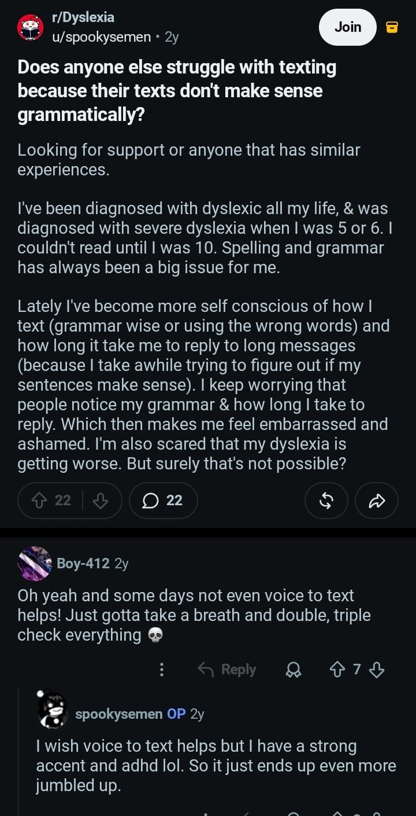
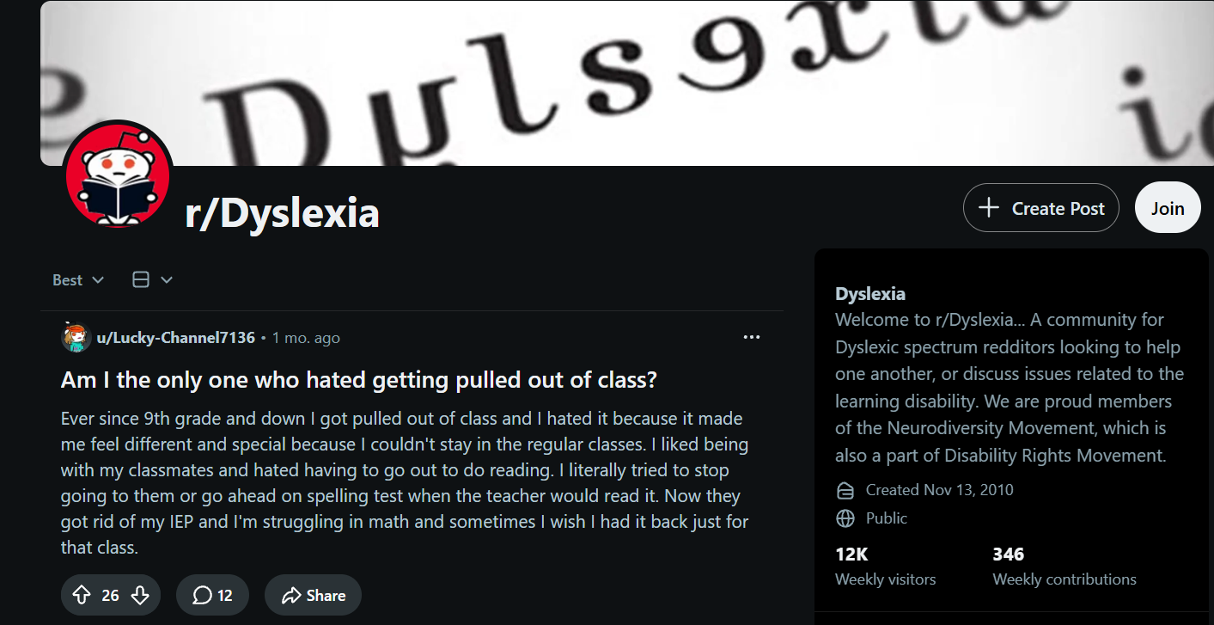
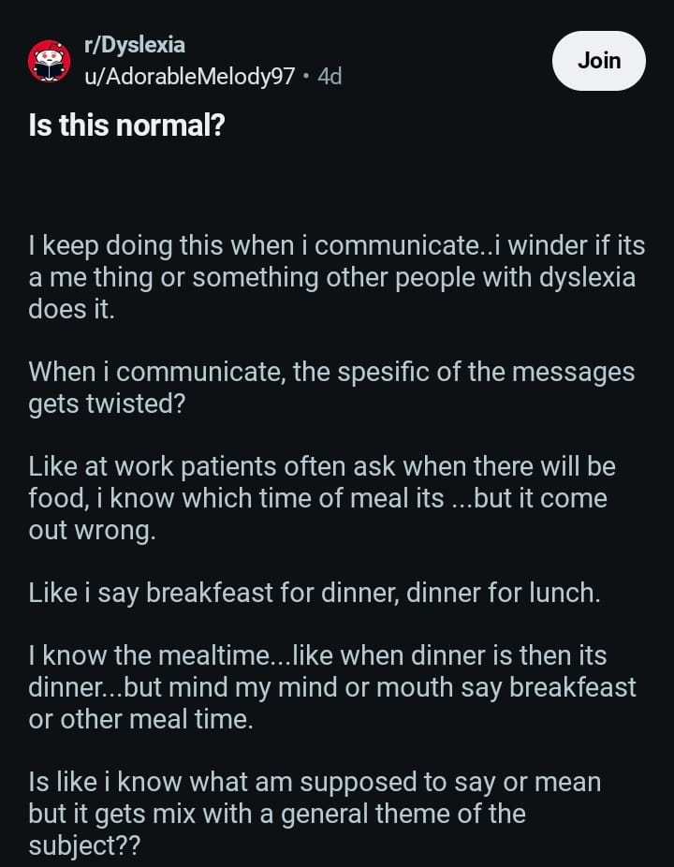
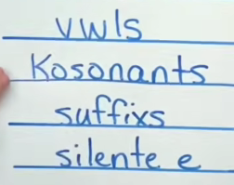
Project Rafeeq
First Milestone
An adaptive, multi-modal digital ecosystem that bridges communication gaps for people with diverse disabilities: Deaf/Mute, Blind, Dyslexic users. Rather than a standalone mobile app, Rafeeq is architected as a lightweight browser extension that injects assistive UI overlays and real-time processing directly into mainstream web communication platforms such as WhatsApp Web and Facebook. meeting users where they already communicate.
Browser-Based Accessibility Extension
language-based learning disorder
Dyslexia
Mute
Deaf

Slide 5
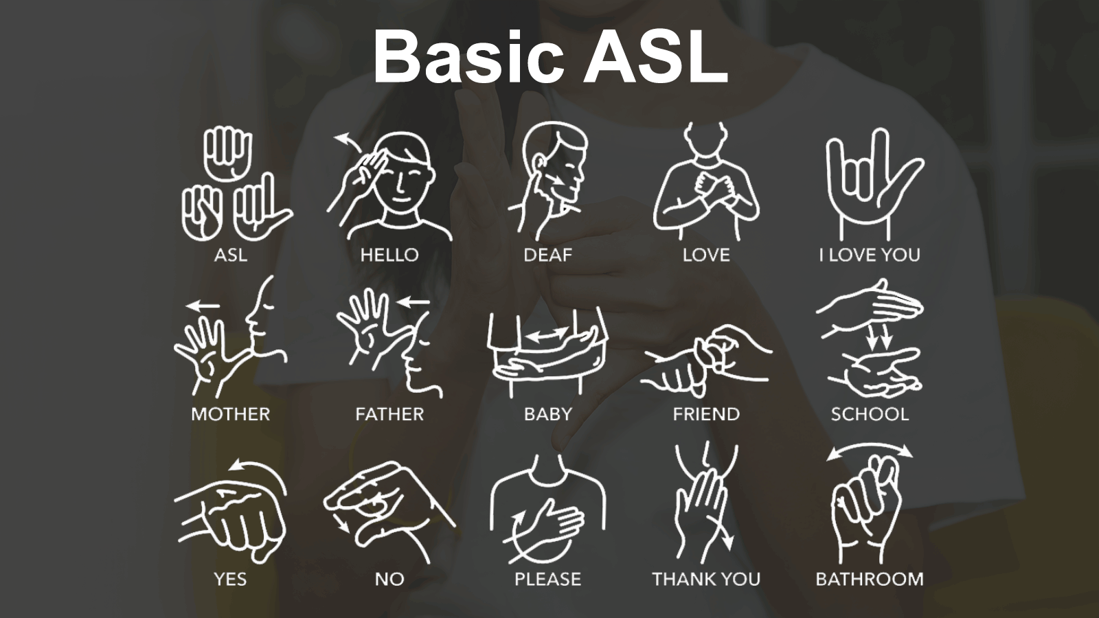
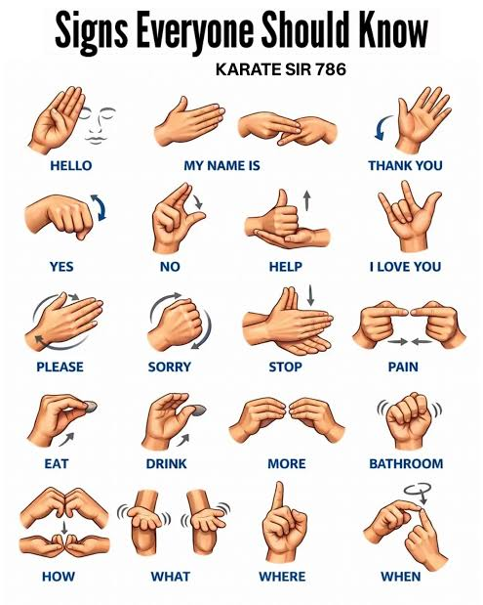
Project Rafeeq
First Milestone
An adaptive, multi-modal digital ecosystem that bridges communication gaps for people with diverse disabilities: Deaf/Mute, Blind, Dyslexic users. Rather than a standalone mobile app, Rafeeq is architected as a lightweight browser extension that injects assistive UI overlays and real-time processing directly into mainstream web communication platforms such as WhatsApp Web and Facebook. meeting users where they already communicate.
Browser-Based Accessibility Extension
Inability to produce spoken voice communication
Dyslexia
language-based learning disorder
A lifelong condition with no medical cure
1 to 2 out of every 10 people experience Dyslexia
They Process things well but find difficulty in expressing
Using Voice or Texting
Community with 7,000 to 39,300 members
Mute
Deaf

Slide 6
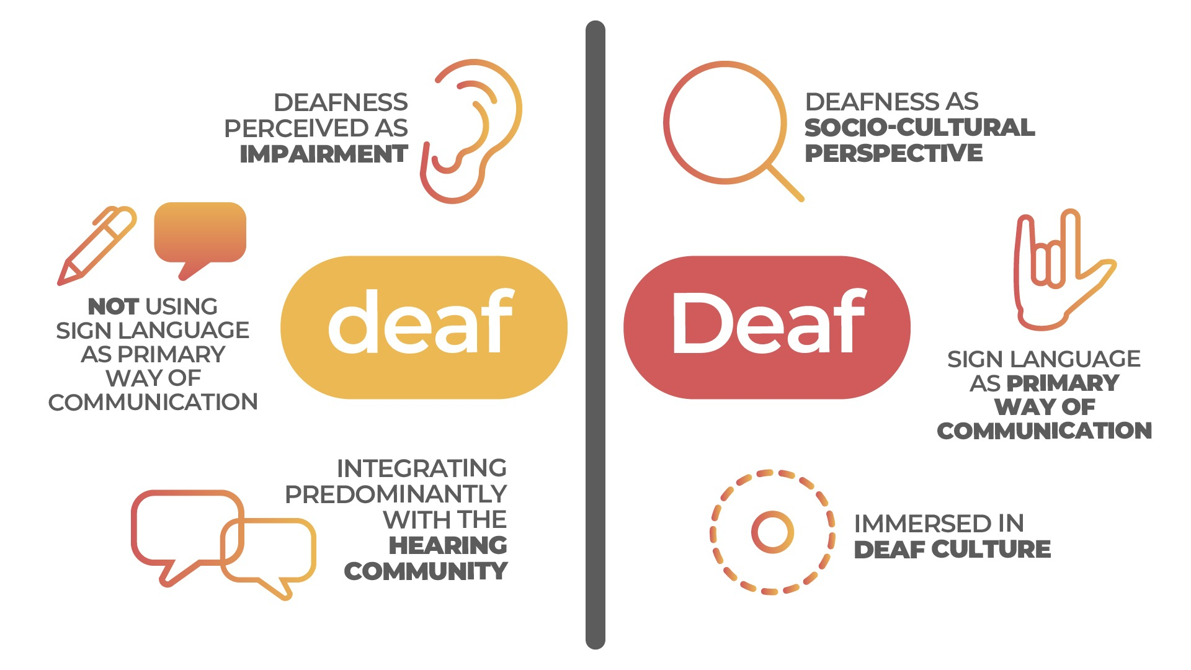
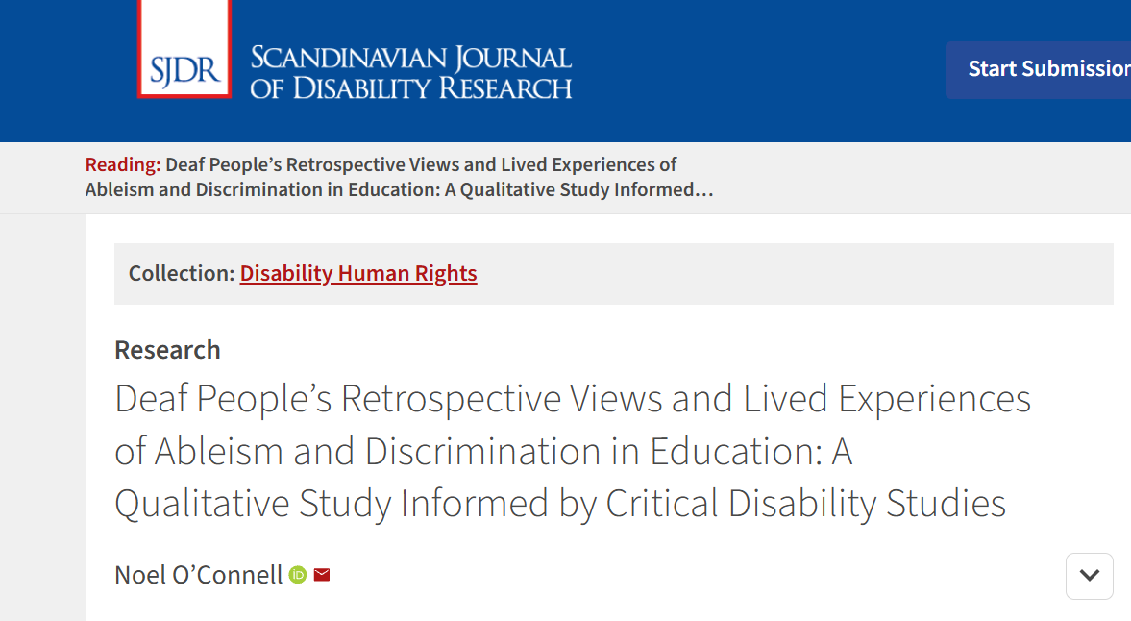
Project Rafeeq
First Milestone
An adaptive, multi-modal digital ecosystem that bridges communication gaps for people with diverse disabilities: Deaf/Mute, Blind, Dyslexic users. Rather than a standalone mobile app, Rafeeq is architected as a lightweight browser extension that injects assistive UI overlays and real-time processing directly into mainstream web communication platforms such as WhatsApp Web and Facebook. meeting users where they already communicate.
Browser-Based Accessibility Extension
Hard of Hearing (D/HH)
Dyslexia
Mute
language-based learning disorder
Inability to produce spoken voice communication
A lifelong condition with no medical cure
1 to 2 out of every 10 people experience Dyslexia
They Process things well but find difficulty in expressing
Using Voice or Texting
Community with 7,000 to 39,300 members
Cannot use voice calls, voice notes, or standard spoken audio apps.
Fully rely on text messaging
Texting is slow and lacks real-time expression
mainstream apps do not translate sign language into speech or text automatically.
Deaf

Slide 7
Project Rafeeq
First Milestone
An adaptive, multi-modal digital ecosystem that bridges communication gaps for people with diverse disabilities: Deaf/Mute, Blind, Dyslexic users. Rather than a standalone mobile app, Rafeeq is architected as a lightweight browser extension that injects assistive UI overlays and real-time processing directly into mainstream web communication platforms such as WhatsApp Web and Facebook. meeting users where they already communicate.
Browser-Based Accessibility Extension
Dyslexia
Deaf
Mute
language-based learning disorder
Hard of Hearing (D/HH)
Inability to produce spoken voice communication
A lifelong condition with no medical cure
1 to 2 out of every 10 people experience Dyslexia
They Process things well but find difficulty in expressing
Using Voice or Texting
Community with 7,000 to 39,300 members
Cannot hear incoming voice call audio, meetings, or video audio.
Mainstream communication apps lack native live captioning overlays for incoming audio.
Cannot use voice calls, voice notes, or standard spoken audio apps.
Fully rely on text messaging
Texting is slow and lacks real-time expression
mainstream apps do not translate sign language into speech or text automatically.

Slide 8
Project Rafeeq
First Milestone
An adaptive, multi-modal digital ecosystem that bridges communication gaps for people with diverse disabilities: Deaf/Mute, Blind, Dyslexic, and Aphasic users. Rather than a standalone mobile app, Rafeeq is architected as a lightweight browser extension that injects assistive UI overlays and real-time processing directly into mainstream web communication platforms such as WhatsApp Web and Facebook. meeting users where they already communicate.
Some Talking About Sickness? (Soft Stuff)
Browser-Based Accessibility Extension
Deaf
Hard of Hearing (D/HH)
Cannot hear incoming voice call audio, meetings, or video audio.
Mainstream communication apps lack native live captioning overlays for incoming audio.
Natural Language Processing (NLP)
Computer Vision
(CV)

Slide 9
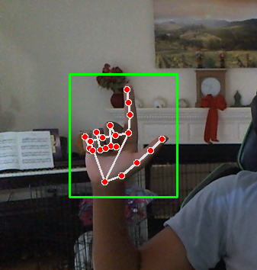
Project Rafeeq
First Milestone
An adaptive, multi-modal digital ecosystem that bridges communication gaps for people with diverse disabilities: Deaf/Mute, Blind, Dyslexic, and Aphasic users. Rather than a standalone mobile app, Rafeeq is architected as a lightweight browser extension that injects assistive UI overlays and real-time processing directly into mainstream web communication platforms such as WhatsApp Web and Facebook. meeting users where they already communicate.
Browser-Based Accessibility Extension
Computer Vision
(CV)
From Deaf/Mute to Hearing
Processing visual sign language gestures locally inside the browser extension.
Live Camera & Audio: The browser extension captures the user's video locally for sign input, and records or receives audio/text from the other person.
Extracting Points: MediaPipe tracks hand points and body landmarks for sign gestures instead of processing heavy video.
Cleaning Data: The system adjusts measurements so camera distance does not affect results, and handles text/audio normalization.
Translating Both Ways:
  Sign-to-Text: A small AI model turns hand gestures into words, and an LLM turns those words into a clean sentence for hearing users.
  Text/Audio-to-Sign (or Captions): Processes incoming speech or text via STT to display clear, instant captions for the deaf/mute user.
Natural Language Processing (NLP)

Slide 10
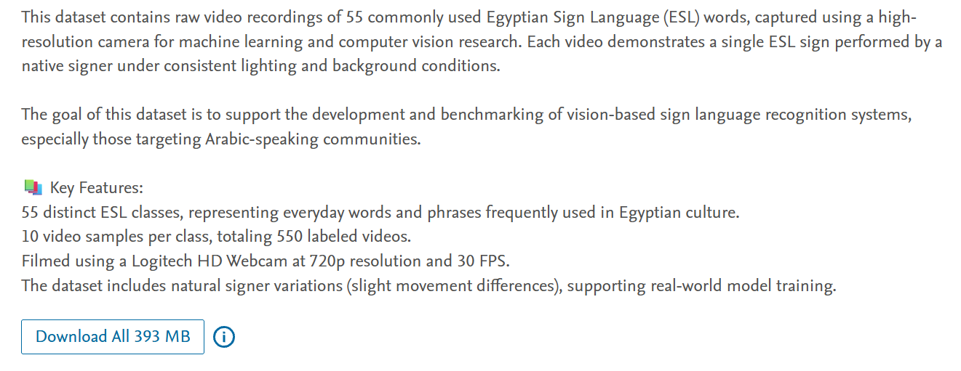
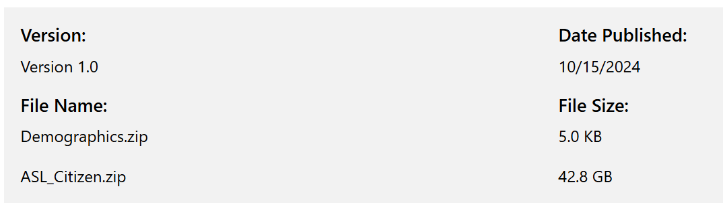
Project Rafeeq
First Milestone
An adaptive, multi-modal digital ecosystem that bridges communication gaps for people with diverse disabilities: Deaf/Mute, Blind, Dyslexic, and Aphasic users. Rather than a standalone mobile app, Rafeeq is architected as a lightweight browser extension that injects assistive UI overlays and real-time processing directly into mainstream web communication platforms such as WhatsApp Web and Facebook. meeting users where they already communicate.
Browser-Based Accessibility Extension
Computer Vision
(CV)
From Deaf/Mute to Hearing
Dataset Strategy: Egyptian Core, ASL Pretraining, & Letters
Processing visual sign language gestures locally inside the browser extension.
Balancing local sign language relevance with robust model training and alphabet support.
Live Camera & Audio: The browser extension captures the user's video locally for sign input, and records or receives audio/text from the other person.
Extracting Points: MediaPipe tracks hand points and body landmarks for sign gestures instead of processing heavy video.
Cleaning Data: The system adjusts measurements so camera distance does not affect results, and handles text/audio normalization.
Translating Both Ways:
  Sign-to-Text: A small AI model turns hand gestures into words, and an LLM turns those words into a clean sentence for hearing users.
  Text/Audio-to-Sign (or Captions): Processes incoming speech or text via STT to display clear, instant captions for the deaf/mute user.
Live Camera: The browser extension uses the webcam to capture video locally, keeping user data private.
Extracting Points: MediaPipe tracks hand points and body landmarks instead of processing heavy video.
Cleaning Data: The system adjusts measurements so camera distance does not affect results.
Turning to Text: A small AI model turns the hand gestures into words, and an LLM turns those words into a clean sentence.
Primary Core (Egyptian Sign Language): Relies on the Mendeley ESL Dataset containing 55 common words across 550 videos recorded by a native signer.
ASL Pretraining Safety Path: Uses American Sign Language datasets like ASL Citizen (Microsoft Research) and Kaggle ASL Signs for pretraining to learn general hand movements and provide a reliable fallback demo.
Optional Alphabet Support: Integrates the ArASL2018 Dataset (featuring over 54,000 images across 32 letters) to support fingerspelling words or names letter-by-letter.
Team Testing: Generalization is tested using recordings of project team members mimicking signs under different lighting and camera setups.
Natural Language Processing (NLP)

Slide 11
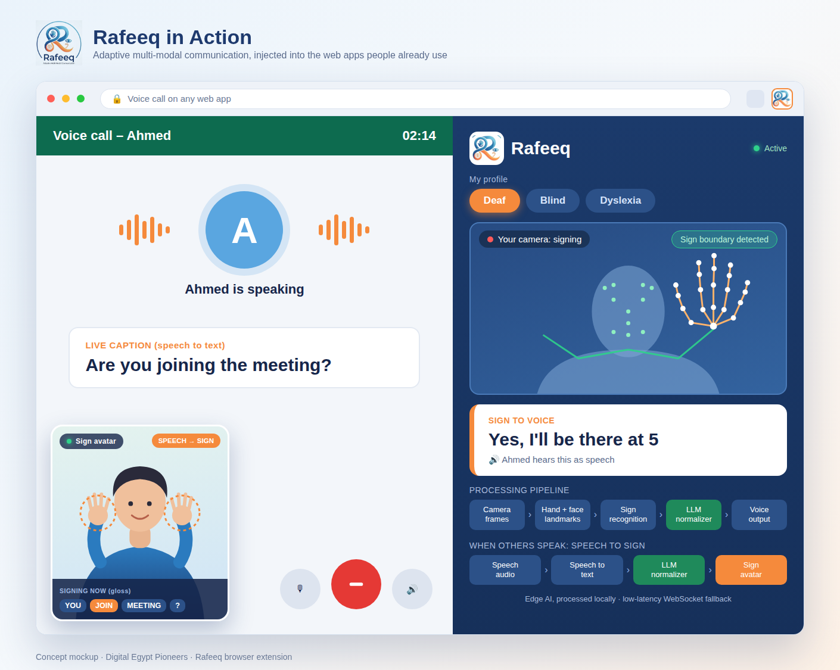
Project Rafeeq
First Milestone
An adaptive, multi-modal digital ecosystem that bridges communication gaps for people with diverse disabilities: Deaf/Mute, Blind, Dyslexic, and Aphasic users. Rather than a standalone mobile app, Rafeeq is architected as a lightweight browser extension that injects assistive UI overlays and real-time processing directly into mainstream web communication platforms such as WhatsApp Web and Facebook. meeting users where they already communicate.
System Workflow: Browser Extension & Website
Browser-Based Accessibility Extension
Computer Vision
(CV)
Natural Language Processing (NLP)
Edge Deployment & Performance Targets
The Issue: Building a custom model from scratch gave poor accuracy/results.
The Pivot: Dropping the traditional NLP pipeline approach and moving to using LMs (Language Models) instead.
Dataset Strategy: Egyptian Core, ASL Pretraining, & Letters
Lightweight, real-time execution directly inside the browser.
Balancing local sign language relevance with robust model training and alphabet support.
Primary Core (Egyptian Sign Language): Relies on the Mendeley ESL Dataset containing 55 common words across 550 videos recorded by a native signer.
ASL Pretraining Safety Path: Uses American Sign Language datasets like ASL Citizen (Microsoft Research) and Kaggle ASL Signs for pretraining to learn general hand movements and provide a reliable fallback demo.
Optional Alphabet Support: Integrates the ArASL2018 Dataset (featuring over 54,000 images across 32 letters) to support fingerspelling words or names letter-by-letter.
Team Testing: Generalization is tested using recordings of project team members mimicking signs under different lighting and camera setups.
NLP Or LLM Or Both?
Why Landmarks? Using extracted landmark points instead of heavy raw video requires less data, ignores background/skin color changes, and keeps user video completely private.
Web Deployment: Models are converted using TensorFlow.js or ONNX Runtime Web to run smoothly inside the browser extension.
Performance Target: Designed to deliver fast results in under half a second at 15+ frames per second (FPS).
Hallucination Mitigation: Strict constraint rules to prevent model drift and incorrect sign-to-text translations, keeping output grounded in valid gloss tokens.
Hybrid Processing Model (Speed vs. Power):
  Traditional NLP (Local / No Internet): Extremely fast, lightweight tokenization, pattern matching, and normalization running entirely client-side.
  LLMs (Cloud / With Internet): Used for deeper context, complex Arabic grammar restructuring, and fluent sentence generation where internet is available.
Results: Use Both
Extension

Slide 12
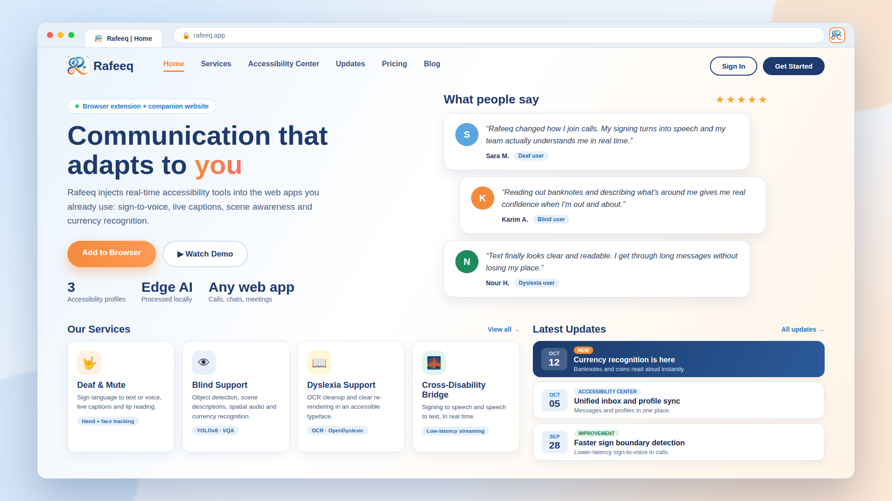

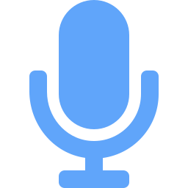


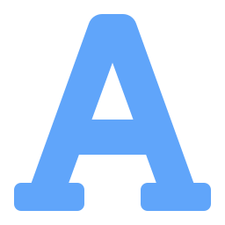
Project Rafeeq
First Milestone
An adaptive, multi-modal digital ecosystem that bridges communication gaps for people with diverse disabilities: Deaf/Mute, Blind, Dyslexic, and Aphasic users. Rather than a standalone mobile app, Rafeeq is architected as a lightweight browser extension that injects assistive UI overlays and real-time processing directly into mainstream web communication platforms such as WhatsApp Web and Facebook. meeting users where they already communicate.
Browser-Based Accessibility Extension
Computer Vision
(CV)
Natural Language Processing (NLP)
System Workflow: Browser Extension & Website
The Issue: Building a custom model from scratch gave poor accuracy/results.
The Pivot: Dropping the traditional NLP pipeline approach and moving to using LMs (Language Models) instead.
NLP Or LLM Or Both?
Hallucination Mitigation: Strict constraint rules to prevent model drift and incorrect sign-to-text translations, keeping output grounded in valid gloss tokens.
Hybrid Processing Model (Speed vs. Power):
  Traditional NLP (Local / No Internet): Extremely fast, lightweight tokenization, pattern matching, and normalization running entirely client-side.
  LLMs (Cloud / With Internet): Used for deeper context, complex Arabic grammar restructuring, and fluent sentence generation where internet is available.
Results: Use Both
Extension
Our Next Milestone
Keep Brief
Person A
Speech
Adaptive router
Speech recognition
Text
Person B
Website

Slide 13
Project Rafeeq
First Milestone
An adaptive, multi-modal digital ecosystem that bridges communication gaps for people with diverse disabilities: Deaf/Mute, Blind, Dyslexic, and Aphasic users. Rather than a standalone mobile app, Rafeeq is architected as a lightweight browser extension that injects assistive UI overlays and real-time processing directly into mainstream web communication platforms such as WhatsApp Web and Facebook. meeting users where they already communicate.
Our Next Milestone
Browser-Based Accessibility Extension
Computer Vision
(CV)
Natural Language Processing (NLP)
System Workflow: Browser Extension & Website
Website
Extension

Slide 14
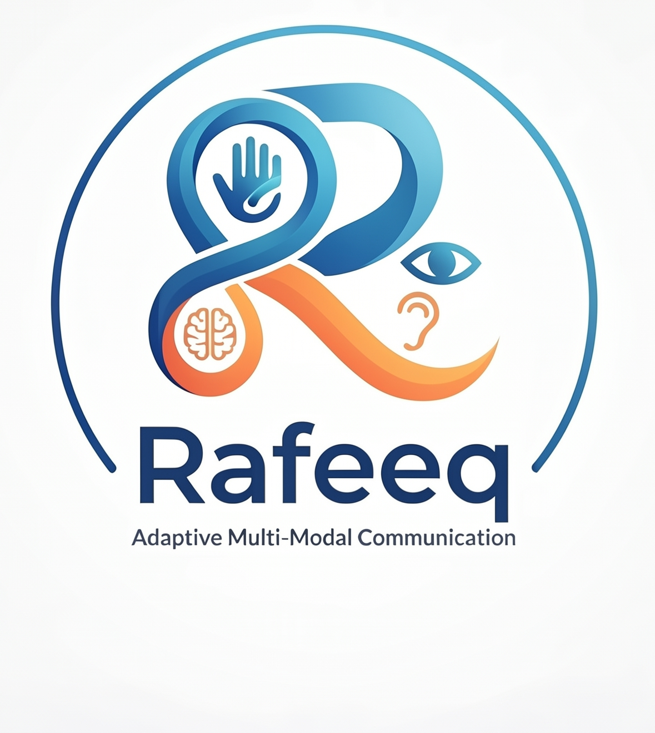
Project Rafeeq
First Milestone
An adaptive, multi-modal digital ecosystem that bridges communication gaps for people with diverse disabilities: Deaf/Mute, Blind, Dyslexic, and Aphasic users. Rather than a standalone mobile app, Rafeeq is architected as a lightweight browser extension that injects assistive UI overlays and real-time processing directly into mainstream web communication platforms such as WhatsApp Web and Facebook. meeting users where they already communicate.
Show Extention/Web LookLike maybe video? Logo??
System Workflow: Browser Extension & Website
Browser-Based Accessibility Extension
Computer Vision
(CV)
Natural Language Processing (NLP)
Our Next Milestone
Developing our core web extension infrastructure while researching new accessibility frontiers.
Core Extension & Website Build: Actively engineering the frontend user interface and companion website architecture alongside backend and frontend integration.
System Pipeline: Establishing robust communication between the local browser capture extension and processing services.
Future Research: Exploring early-stage research into aphasia support to see how our language and text normalization models can assist users with speech and language processing impairments.
Website

